Slide 1


Coordinated Care Initiative (CCI) BASICS: Preparing for Changes
Amber Cutler, Staff Attorney
National Senior Citizens Law Center
Silvia Yee, Senior Attorney
Disability Rights Education & Defense Fund
August 22, 2013

Slide 3

O
Founded in 1979, by people with disabilities and parents of children with disabilities, the Disability Rights Education and Defense Fund (DREDF) is a leading national law and policy center, based in Berkeley, CA, dedicated to protecting and advancing the civil and human rights of people with disabilities. For more information, visit us at www.DREDF.org

Slide 4

Coordinated Care Initiative: In a Nutshell
What
Mandatory Medi-Cal for all SPDs
LTSS Integration
Medicare Integration
Who
Dual eligibles
Medi-Cal only SPDs
Where
8 counties: Alameda, Los Angeles, Orange, Riverside, San Bernardino, San Diego, San Mateo, Santa Clara
When
April 1, 2014*
Why
Coordinate Care
Save Money
Notes:
Basics training:
Focus on What, Who, Where, When, and Why
In a nutshell: The CCI is a new state program that changes the delivery of Medi-Cal, Long term supports and services, and Medicare to dual eligibles and seniors and persons with disabilities living in eight California counties, which is set to begin no sooner than April 1, 2014, aimed at coordinating care and reducing health care spending.
Point out that the date is now April 1, 2014 – DHCS made this decision last week.

Slide 5
Glossary
Coordinated Care Initiative (CCI)
Cal MediConnect
Dual Eligible (Dual) or Medi-Medi
Fee-for-Service (FFS)
Long Term Support and Services (LTSS)
In-Home Supportive Services (IHSS), Community Based Adult Services (CBAS), Multipurpose Senior Services Program (MSSP), Nursing Facility
Medi-Cal Managed Care
Program of All-Inclusive Care for the Elderly (PACE)
Seniors and Persons with Disabilities (SPDs)
Notes:
LTSS – define
IHSS – In Home Supportive Services – a Medi-Cal benefit that allow a beneficiary to remain safely in the home rather than in a nursing facility or other institution – house cleaning, shopping, meal preparation, laundry, personal care services, medical appointment accompaniment. County administered and individuals are assessed by the county for hours needed.
CBAS – community based adult services – formerly adult day health care – licensed community-based day health program that provides services to older persons with chronic medical, cognitive, or mental conditions or disabilities that are at risk for needing institutional care. Must meet eligibility requirements.
MSSP – multi-purpose senior service program – at a site provide social and health care management for frail elderly clients who are certifiable for nursing home placement but who wish to remain in the community. Must meet eligibility requirements. Provides comprehensive care management services. 38 sites statewide. Services include housing assistance, shore and personal assistance, respite, transportation, meal services, social services, etc.
Nursing Facility.
PACE – provides comprehensive long term services and supports to dual eligible beneficiaries. A type of managed care plan that combines an individuals benefits – must meet eligibility requirements, namely being eligible for nursing home care but able to live safely in the community; PACE program must be available in the service area.
SPDs – individuals who have Medi-Cal only – not Medicare – so not dual eligibles. These are individuals who receive Medi-Cal based on age or disability.

Slide 6
CCI = three big changes
What
CCI Change | Description | Federal Approval
Mandatory Medi-Cal Managed Care | Duals and previously excluded SPDs must in enroll in Medi-Cal Managed Care | Pending
LTSS Integration | LTSS added to Medi-Cal Managed Care plan benefit package | Pending
Medicare Integration (Cal MediConnect) | For duals, integration of Medicare and Medi-Cal benefits into one managed care plan. | Approved

Slide 7
The current Medi-Cal, LTSS, and Medicare delivery systems are different
What
Current System
Medi-Cal
(medical services)
Medi-Cal
(LTSS services)
Medicare
OR
OR
FFS
Managed care
FFS
Managed care
FFS
(default)
*Behavioral Health

Slide 8
CCI moves services into managed care
What
New System
Medi-Cal
(medical services)
Medi-Cal
(LTSS services)
Medicare
Managed Care
*Behavioral Health
Notes:
Behavioral Health – still provided in county based mental health –

Slide 9
Fee-for-service: providers paid for each service provided
What
Senior/Person with Disability
Provider
Provider
Provider
$$
$$
DHCS & Medicare
$$

Slide 10
Managed Care: Plans paid to provide covered services via network providers
What
Senior/Person with Disability
Health Plan
$$
DHCS & Medicare
Provider
Provider
Provider

Slide 11
Who
CCI impacts duals & seniors and persons
with disabilities with Medi-Cal
Medi-Cal and Medicare
(Dual Eligibles)
Impacted
Not
Impacted
Medi-Cal only
(SPDs)
Medicare Only

Slide 12
Different groups of duals and SPDs are affected differently
Who
SPDs that are already required to enroll in Medi-Cal managed care
SPDs that will remain exempt from mandatory Medi-Cal managed care enrollment
Dual eligibles that will be passively enrolled into Cal MediConnect
Dual eligibles that can enroll into Cal MediConnect, but will not be passively enrolled
Dual eligibles that cannot enroll in Cal MediConnect

Slide 13
Total Impact: 1,010,000
Who
County | Duals Subject to Passive Enrollment in Cal MediConnect (2014) | Medi-Cal MC Only
Alameda | 25, 502 | Unknown
Los Angeles | 223,084 (200,000 cap) | Unknown
Orange | 39,969 | Unknown
Riverside | 24,395 | Unknown
San Bernardino | 26,977 | Unknown
San Diego | 41,710 | Unknown
San Mateo | 3,701 | Unknown
Santa Clara | 32, 986 | Unknown
Totals | 418,324 (395,204 with cap) | 592,000

Slide 14
Only Duals can enroll in Cal MediConnect
What
Duals
Only
Passive Enrollment
Cal Medi Connect

Slide 15
What
Medicare
Medi-Cal
Opt-In
Choose Cal MediConnect Plan
Dual
(subject to passive enrollment)
FFS Medicare
Choose Medi-Cal Plan
Opt-Out
Medicare Advantage
Assigned to Medi-Cal Plan
Do Nothing
Enrolled into
Cal MediConnect Plan

Slide 16
Medi-Cal Managed Care Mandatory
What
Even if a Dual Opts Out of Cal MediConnect, must still enroll in Medi-Cal MC
Medi-Cal Only
Duals
Medi-Cal
Managed Care

Slide 17
Medicare Advantage and D-SNP members not subject to passive enrollment
Who
DUALS ENROLLED IN MEDICARE ADVANTAGE OR A D-SNP ARE NOT SUBJECT TO PASSIVE ENROLLMENT IN CAL MEDICONNECT IN 2014
MUST STILL ENROLL IN MEDI-CAL MANAGED CARE

Slide 18
Cal MediConnect Benefits
What
Specialty mental health services
Provided Outside of Plan
Extra IHSS like services
HCBS waiver like services
Care Plan Option Services
Medi-Cal services including LTSS
Medicare A, B, D
Plans Required to Provide
Vision and Transportation
Care Coordination
IHSS, CBAS, SNF, MSSP
Behavioral health Drug Medi-Cal benefits

Slide 19
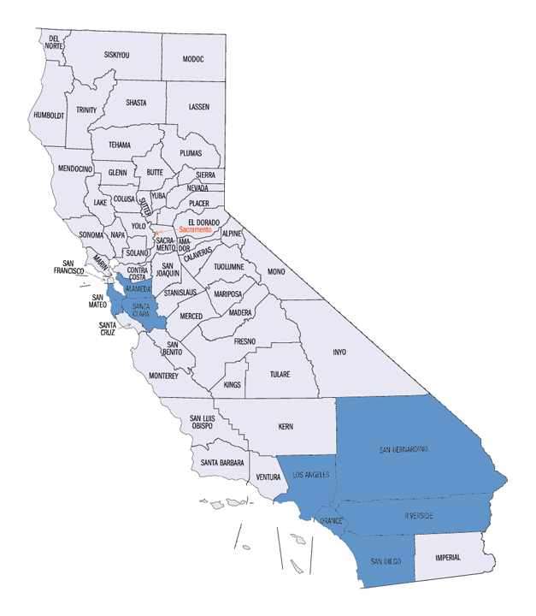
CCI will be implemented in 8 counties
Where
Alameda
Los Angeles
Orange
Riverside
San Bernardino
San Diego
San Mateo
Santa Clara

Slide 20
Different Cal MediConnect plans available in each county
Where
County | Plan(s)
Alameda | Alameda Alliance for Health Anthem Blue Cross/Caremore
Orange | Cal Optima
San Mateo | Health Plan of San Mateo
Riverside & San Bernardino | Inland Empire Health Plan Molina Health Care
Santa Clara | Anthem Blue Cross Santa Clara Family Health Plan
San Diego | Community Health Group Care 1st Health Net Molina

Slide 21
LA county includes several subcontracted plans
Where
LOS ANGELES
Primary Plan(s) | Subcontracted Plans
LA Care | CareMore (Anthem Blue Cross) Care 1st Kaiser*
Health Net

Slide 22
Implementation proposed to begin April 1, 2014
When
90 day notice
1/1
APRIL
1

Slide 23
Enrollment timing and process varies by county
When
 | Alameda, Santa Clara, Orange, Riverside, San Bernardino, & San Diego | San Mateo | Los Angeles
Voluntary Only Enrollment | N/A | N/A | 3 months
Passive Enrollment Begins | 4/1/14 | 4/1/14 | 7/1/14
Passive Enrollment Phased | Over 12 months* | Over 1 month* | ?
Phasing Method | 1st day of birth month (with many exceptions) | All at once | Undecided

Slide 24
Major exceptions to the general enrollment strategies
When
Exception
Duals enrolled in MSSP
Duals already enrolled in Medi-Cal Managed Care in Alameda and Santa Clara
Duals reassigned to Part D effective 1/1/13
Duals subject to Part D reassignment effective 1/1/14
In counties enrolling by birth month, duals born in January

Slide 25
Most beneficiaries will receive three notices
When
90 Day
60 Day
30 Day
ENROLLMENT
April
Enrollment
1/1/14
2/1/14
3/1/14
ENROLLMENT
4/1/14
August
DOB
5/1/14
6/1/14
7/1/14
ENROLLMENT
8/1/14

Slide 26
When
90 Day
Informational Notice
60 Day
Notice with Default Plan
Choice Packet
Health Plan Guide
Provider Directory
30 Day
Final Reminder Notice

Slide 27
DHCS stated goals of the CCI
Why
Improve Access to Care
Promote
Person-Centered Planning
Promote Independence in Community
Right Care
Right Time
Right Place
Cost Savings for State and Federal Government

Slide 28
California is part way through a long process
Wrap Up
State Submitted Letter of Interest
(Nov 2011)
State Submitted Proposal
(May 2012)
Develop LA Enrollment Process
Readiness Reviews
Enrollment
Ongoing monitoring and evaluation
MOU
(March 2013)
Notice Development
Plan Contracting

Slide 29
Should your client enroll in Cal MediConnect?
Wrap Up
Whether to enroll in Cal MediConnect is an individual choice

Slide 30
Factors to Consider in Making Decision to Enroll in Cal MediConnect
Wrap Up
Do plans have networks that include client’s current medical providers?
Does plan have strong relationship with social service providers?
Does client have a course of treatment that should not be interrupted?
How important are the additional benefits vision and transportation to client?
Will a plan improve your client’s care coordination?

Slide 31
What to watch out for: good
Wrap Up
Care Coordination
One Card
Additional required benefits
Possible additional HCBS benefits
Assessments/Care Plans

Slide 32
What to watch out for: bad
Wrap Up
Timing
Confusion/Mistakes
Access to providers
Disruption in care
Other Issues

Slide 33
What can you do?
Wrap Up
Influence program development
Stakeholder meetings
Talk to plans
Legislative advocacy
Prepare to provide counsel
Report problems

Slide 34
Coordinated Care Initiative: In a Nutshell
Wrap Up
What
LTSS Integration
Medicare Integration
April 1, 2014
Where
Why
Mandatory Medi-Cal for all SPDs
8 counties: Alameda, Los Angeles, Orange, Riverside, San Bernardino, San Diego, San Mateo, Santa Clara
Coordinate Care
Save Money
When

Slide 35
Local advocates can help individuals
Wrap Up
HICAP
1-800-434-0222
Health Consumer Alliance
www.healthconsumer.org/index.php?id=partners
Disability Rights California
www.disabilityrightsca.org/

Slide 36
Want to know more?
Wrap Up
NSCLC Duals Website
News
Sign up for alerts
Advocate’s Guide
http://dualsdemoadvocacy.org/
Advanced training 9/11/13
Contact us:
Anna Rich – arich@nsclc.org
Amber Cutler – acutler@nsclc.org
DREDF
www.dredf.org
Silvia Yee – syee@dredf.org
Mary Lou Breslin mlbreslin@dredf.org
510-644-2555
Department of Healthcare Services
www.calduals.org

